Slide 1

Computer network
Course Overview
Dr. Nguyen Quang Uy
FIT-MTA
Email: quanguyhn@gmail.com

Slide 2
Overview
1. Course objectives
2. Outline of the Course
3. Grading policies
4. Course Materials
5. About the lecturer

Slide 3
1. Course objectives
- Investigating the underlining principles in computer networks
- Paying more ettension to the layers in the Internet layer models

Slide 4
1. Who should study the course?
The course is most beneficial for the following students?
Want to do network design and management
Want to conduct network traffic analysis
Want to work in network security
Want to develop network and mobile apps?

Slide 5
1. Prerequisites
Has finished the basic programming course
Familiar with packet tracer and wireshark will be good
Good skill in programming (python, java) will be advantages
continued

Slide 6
2. Outline of the Course
Computer Network
Chapter 1:An overview of computer network
Chapter 2: Network models
Chapter 3: Data-link layer
Chapter 4: Network layer
Chapter 5: Transport layer
Chapter 6: Application layer

Slide 7
2. List of Labs in the Course
Lab 1: Network devices, media and topology
Lab 2: Switch, MAC address learning and resolutions
Lab 3: Router setup and configure
Lab 4: Capture and analyse network packets

Slide 8
2. Schedule in the class
For most class, we will spend about:
2 hours for lectures
The rest is for exercise, discussion or labs

Slide 9
2. Software tools used in the course
Students need to install following tools on their laptop and bring the laptop to the class for the labs:
Packet tracer
Wireshark
continued

Slide 10
3. Grading policies (% of total score)
Attendance: 10%
Mid-term exam: 30% (Paper exam)
Exam 1: Week 7: 10%
Exam 2: Week 13: 20%
Final exam: 60% (Oral exam)
Students who actively participate in the lessions and finish all assignments on time will receive up to 30% point into the mid-term exam.
Students who coding some assignments will also receive bonus points.

Slide 11
3. Non-Attendence Penalty
I may take registration at the start or the end of a class.
If someone is not there, they are marked
(unless they have a good excuse).
Students who are absent for more than 20% hours are not allowed to attend the final test.

Slide 12
4. Course Materials
I will hand out one copy of my slides
you should make copies of them
Online materials: There are numerous interesting materials on the Internet and the lectures for youtube that you can be beneficial.
Data Communications and Networks, by Prof. Steven Gordon.
https://www.youtube.com/watch?v=eOpBk2_lNnw&list=PLvifRcqOOwF8u4iC7hFTMVC_WD6SEpnkx

Slide 13
4. Reading Materials
The main texts used in my notes are:
BehrouzA.Forouzan, Data Communication and Networking, Fifth Edition, McGraw Hill, 2012
Tanenbaum,Computer network, Fifth Edition, Prentice hall, 2011

Slide 14
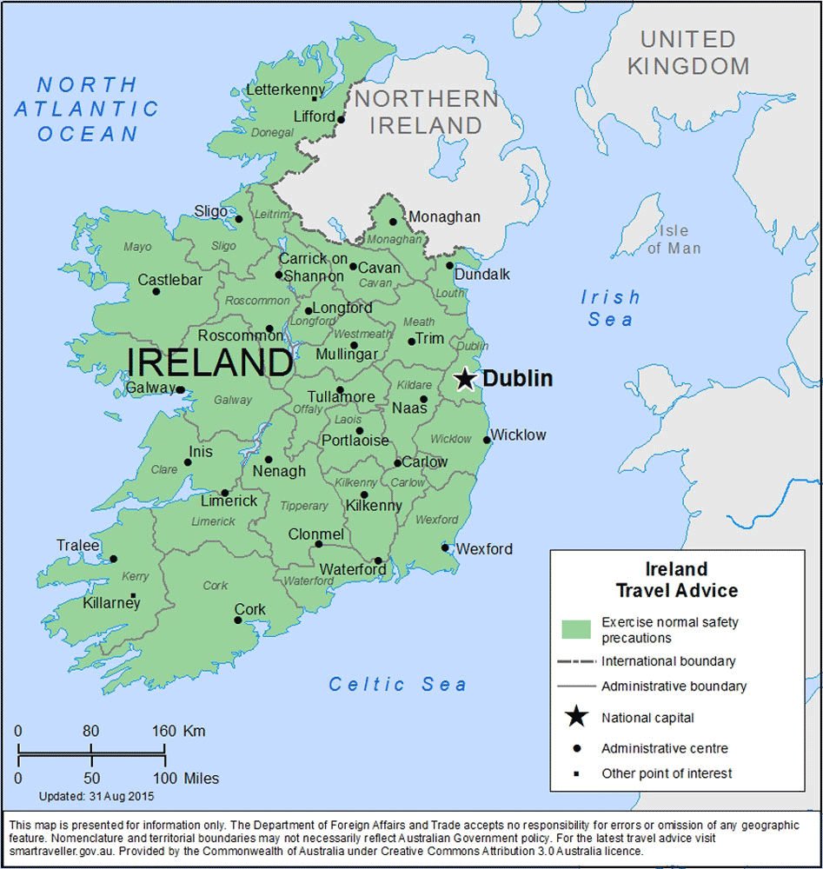

5. About the lecturer
Received bachelor and master degree from MTA in 2004 and 2007 respectively.
Received PhD degree from University College Dublin, Ireland, 2011.

Slide 15

During the course
Please ask questions whenever you have.
The course is expected to be enjoyable.
1/21/16

Slide 16
Thank you!

